Slide 1
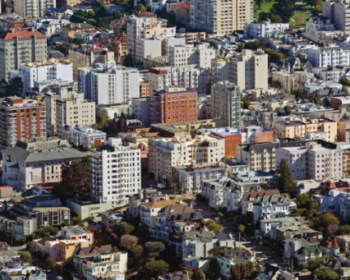
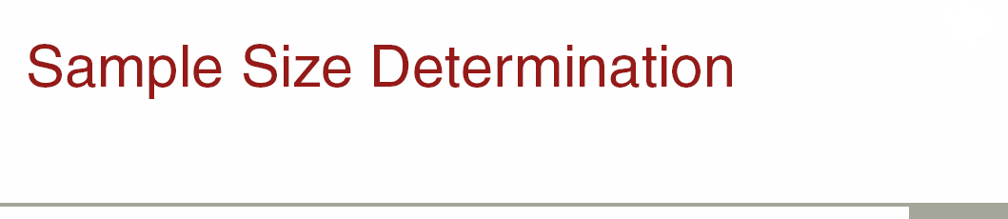
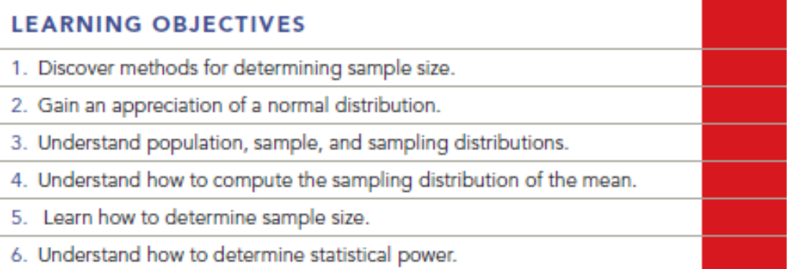
Chapter Fourteen Q & A
14-1

Slide 2
Question
Discuss and give examples of three methods that are used in marketing research for determining sample size.

Slide 3
Answer
The first method is the budget available. If the project has a total budget for data collection of $20,000 and each survey administered costs $20, then the sample size can be no larger than 1,000 people.
The second method is the rule of thumb. This is the case where the sample size is some given number, usually determined by the research client. The client probably has chosen that number because of experience with a previous research project.
The third method is the traditional statistical method where statistical formulas are used to determine the sample size under given variance, level of confidence, and desired error levels.

Slide 4
Question
A market researcher analyzing the fast-food industry noticed the following: The average amount spent at a fast-food restaurant in California was $3.30, with a standard deviation was $0.40. Yet in Georgia, the average amount spent at a fast-food restaurant was $3.25 with a standard deviation of $0.10. What do these statistics tell us about fast-food consumption expenditures in these two states?

Slide 5
Answer
Although the average spent at fast food restaurants in the two states was close, the dispersion was not. This means that the prices paid in California vary more than the prices paid in Georgia.

Slide 6
Question
Assume that previous fast food research has shown that 80 percent of the consumers like curly French fries. The researcher wishes to have an error of 6 percent or less and be 95 percent confident of an estimate to be made about curly French fry consumption from a survey. What sample size should be used for a simple random sample?

Slide 7
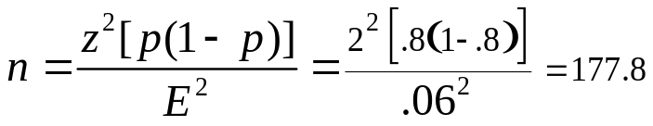
Answer
Where z=2,p=.8, 1-p=1-.8, E=0.06
Thus, a sample size of 178 subjects is needed.

Slide 8
Question
You are in charge of planning a chili cook-off. You must make sure that there are plenty of samples for the patrons of the cook-off. The following standards have been set: a confidence level of 99 percent and an error of less than 4 ounces per cooking team. Last year’s cook-off had a standard deviation in amount of chili cooked of 3 ounces. What is the necessary sample size?

Slide 9
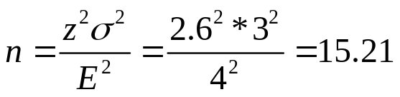
Answer
Z=2.6 for confidence level of 99 percent
  i.e., 2.6 standard errors are required to take in 99% of the area under a normal curve. See appendix one in the end of text book-Exhibit 2.
Thus, a sample of 16 is needed. A sample of 30 will allow more powerful analysis.

Slide 10
Question
Based on a client’s requirements of a confidence interval of 99.74 percent and acceptable sampling error of 2 percent, a sample size of 500 was calculated. The cost to the client is estimated at $20,000. The client replies that the budget for this project is $17,000. What are the alternatives?

Slide 11
Answer
The sample size will have to be reduced to fit the budget, and the client will have to accept a lower confidence interval. Or, the sample size will remain the same, and the client will have to increase the budget by $3,000.

Slide 12
Question
A marketing researcher must determine how many telephone numbers she needs to order from a sample provider to complete a survey of ATM users. The goal is to complete 400 interviews with ATM users. From past experience, she estimates that 60 percent of the phone numbers provided will be working phone numbers. The estimated incidence rate (percentage of people contacted who are ATM users) is 43 percent. Finally, she estimates from previous surveys that 35 percent of the people contacted will agree to complete the survey. How many telephone numbers should she order?

Slide 13
Answer
400 = (.6 * .43 * .35)X. Thus, X= 4,430 telephone numbers.

Slide 14
Question
If we were making inferences from a single sample, we would expect that there would be a ____ percent probability that the sample mean or proportion generated from our sample results would be within two standard errors of the true population mean.
68.26%
99.74%
97.5%
95.44%
98.00%

Slide 15
Answer
Ans: D

Slide 16
Question
When a research company routinely uses samples of 300 for their studies, they are using which type of plan to determine sample size?
the 50% rule
budget available
rule of thumb
number of subgroups to be analyzed

Slide 17
Answer
Ans: C

Slide 18
Question
As the level of tolerable error increases in the sample means formula, the sample size required to represent a particular population is:
smaller
larger
about the same
none of these

Slide 19
Answer
Ans: A

Slide 20
Question
___________ sampling error is the amount of sampling error the researcher is willing to accept.
a. Given
b. Projected
c. Accepted
d. Allowable
e. Tolerable

Slide 21
Answer
Ans: E

Slide 22
Question
Statistical power is the probability of not making which of the following types of error?
Type I
Type II
Type III
Type A
Type B

Slide 23
Answer
Ans: B

Slide 24
Question
A researcher wants to estimate a population mean. The level of tolerable sampling error is 0.2 of a purchase occasion, with a confidence level of 95.44%. If the estimated population variance is 5 for the most important question in the study, what is the desired sample size?

Slide 25
Answer
Ans: 1) at 95.44% confidence, Z = 2
2) sample means formula is appropriate
3) Variance = 5
4) Tolerable Error = .2
5) Computed Sample size of 500
n=(4*5/0.2^2)=500

